Slide 1
SALOON SLOT
BOOKING SYSTEM
SAIKRISHNA H - 220701238
RISHI KARTHIK P - 220701225
DATE : 22-05-2024

Slide 2
PROBLEM
STATEMENT
Time-consuming phone calls and in-person visits
Difficulty managing appointment clashes
Limited booking flexibility for customers
Inaccurate estimations of waiting times
The Challenge of Manual Booking

Slide 3
PROPOSED SOLUTION
Online platform for booking appointments (web or mobile app)
Real-time slot availability displayed
Integration with customer database for booking history access
Flexible cancellation options (up to 4 hours prior)
SALOON SLOT BOOKING SYSTEM

Slide 4
SYSTEM ARCHITECTURE
Database Management System (DBMS): Stores customer data, appointments, and staff information (using SQL)
Python Programming: Facilitates interaction with the database and user interface development
User Interface (Web or Mobile App): Provides a user-friendly platform for booking and managing appointments
Building the System with Efficiency

Slide 5
SYSTEM FUNCTIONALITIES
Browse available slots for various services offered by the salon
Select a preferred stylist (if applicable)
Book appointments conveniently (24/7 access)
View and manage booking history
Cancel appointments within the designated timeframe (4 hours )
CUSTOMER END : Streamlined Booking for Customers

Slide 6
SYSTEM FUNCTIONALITIES
System access for authorized personnel (admins and managers)
Manage staff profiles and assign roles (e.g., stylist, receptionist)
View and modify appointment schedules (including blocking slots for specific reasons)
Track cancellations and no-shows to identify trends
Generate reports on bookings, revenue, and staff performance
Manage customer database
ADMIN / MANAGER : Empowering Staff for Improved Management

Slide 7
TECHNOLOGY STACK
Programming Language: Python (flexible and beginner-friendly)
Database Management System (DBMS): SQL (widely adopted and powerful)
The Tools Behind the System

Slide 8
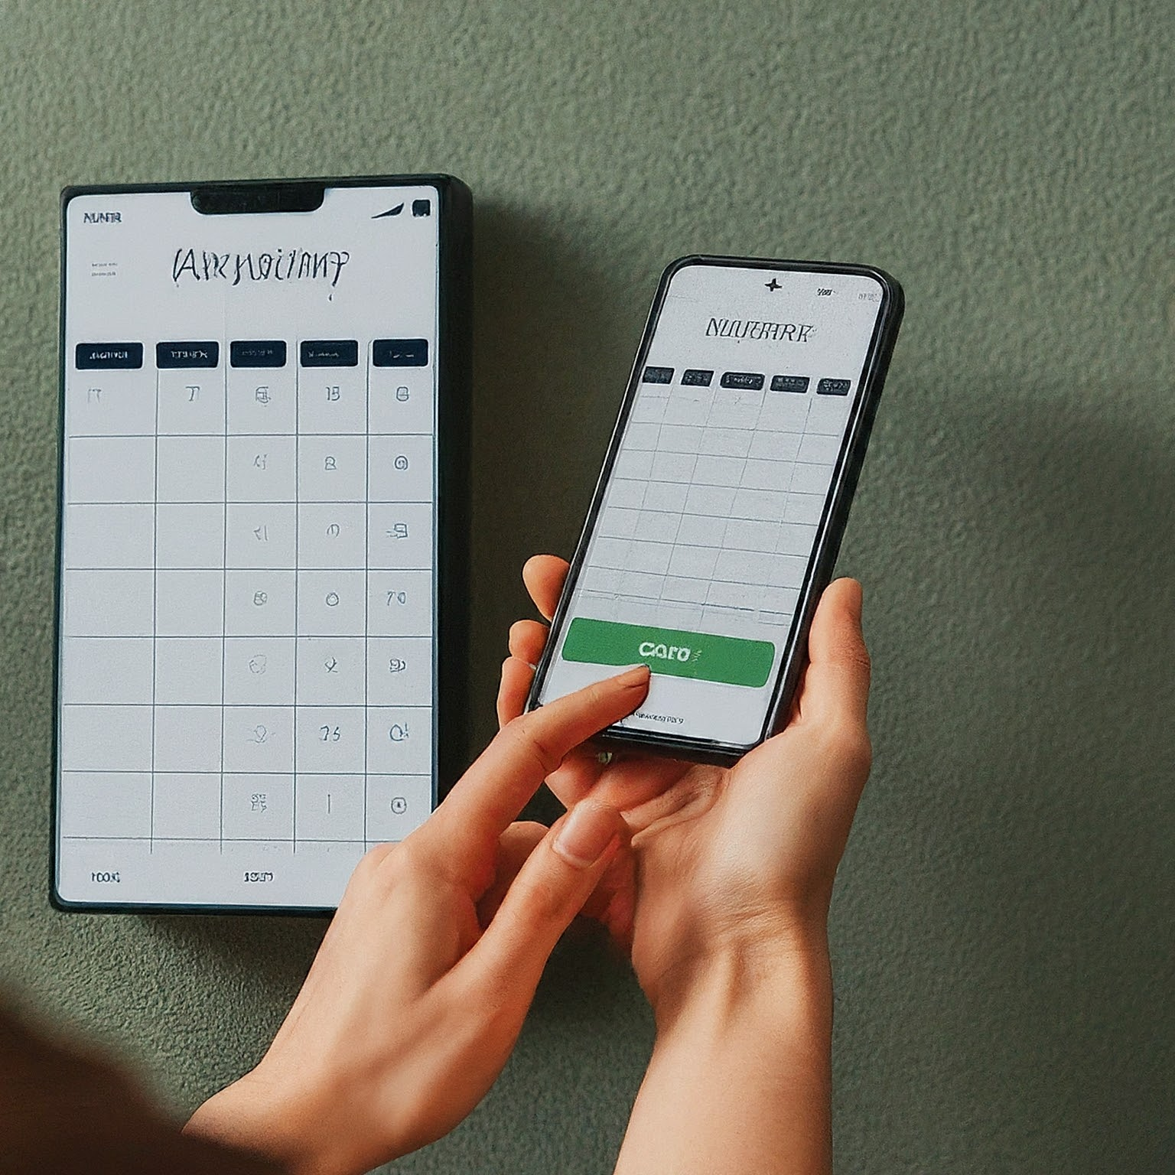
THANK YOU !!
SALOON SLOT BOOKING SYSTEM

